Slide 1

AtliQ Hospitality Analysis

Slide 2
Introduction
AtliQ Grands owns multiple five-star hotels across India.
They have been in the hospitality industry for the past 20 years.
Due to strategic moves from other competitors and ineffective decision-making in management, AtliQ Grands are losing its market share and revenue in the luxury/business hotels category.

Slide 3
Main KPI’s
Revenue
Total Bookings
Occupancy%
Total Successful Bookings
Total Cancelled Bookings
Cancellation Rate
Average Rating
Total Capacity

Slide 4
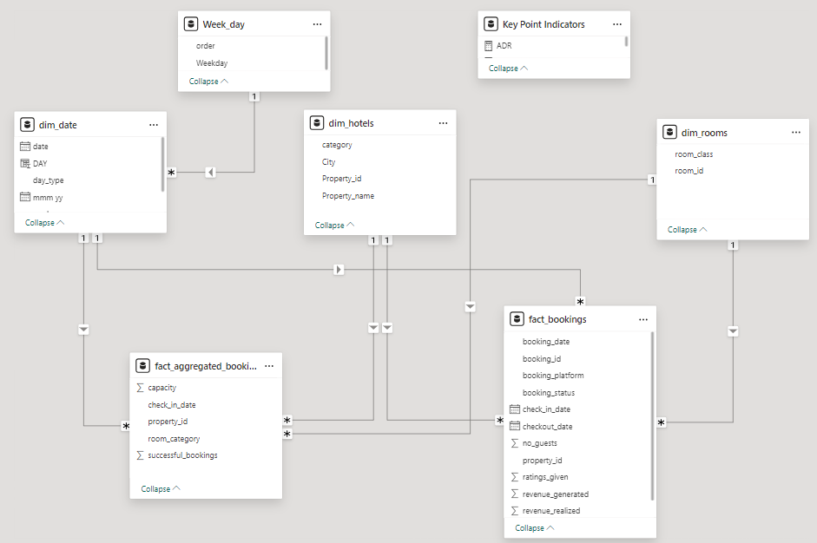
Data Model

Slide 5
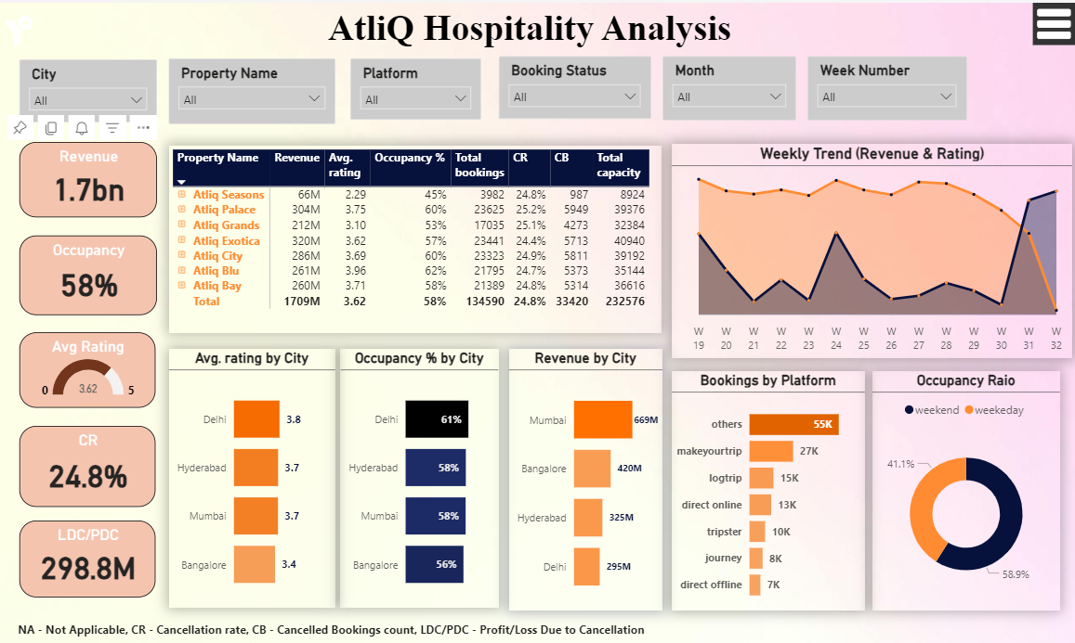

Slide 6
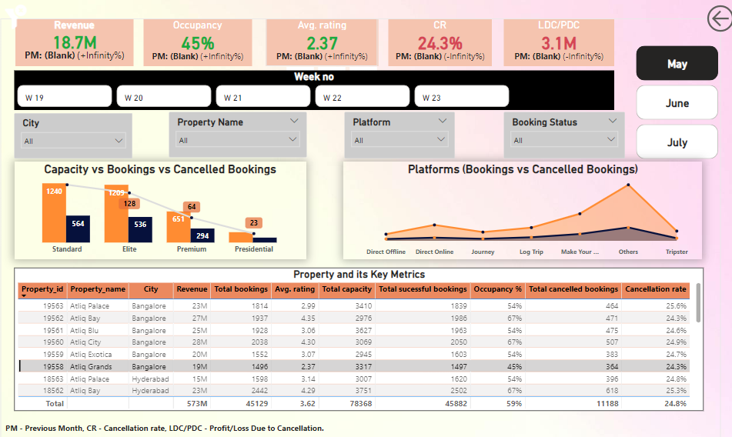

Slide 7
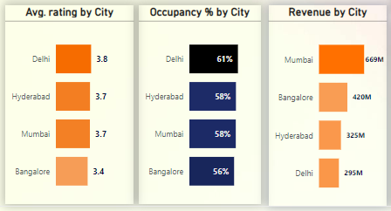
Insights:
Delhi emerges as the top performing city in both Occupancy% and Average rating.
Mumbai leads in revenue generation at 669M (39.13%) followed by Bangalore (24.6%), Hyderabad (19.03%), Delhi (17.23%).

Slide 8
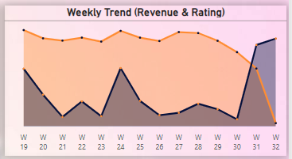
Insights:
In the analysis of AtliQ Hotels performance in India for weeks 19 to 32 of 2022, certain trends stand out.
Week 32 has high Average rating of 3.65, while Week 21 has slightly lower ratings of 3.61
Week 24 has highest revenue of 139.6M, while Week 32 has lowest revenue of 3.9M.

Slide 9
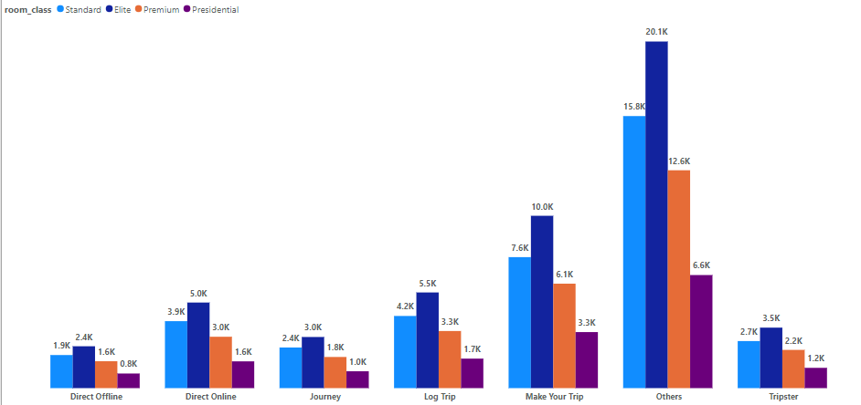
Insights:
Direct offline bookings indicates a lower count and ratings by 6.02%, whereas bookings through other platforms shows higher ratings.
Notably, bookings via Make Your Trip account are 19.9% of the total with revenue generation of 340.8M.
Among room types, Elite rooms secure the highest number of bookings, comprising 49.5K (36.78%).
Following Elite rooms are Standard rooms at 28.57%, Premium rooms at 22.71%, and Presidential rooms at 11.94%.

Slide 10
Insights:
AtliQ Blu has the highest occupancy rate at 62%, highlighting significant demand for this property.
While, AtliQ Seasons records the lowest occupancy rate at 45%, indicating potential areas for improvement.
In terms of cancellation rate, AtliQ Palace experiences the highest rate at 25.2%, closely followed by AtliQ Gardens and AtliQ City.
Whereas, AtliQ Exotica registers the lowest cancellation rate at 24.4%.
The cancellations incurred by AtliQ resulted in a substantial loss of approximately 300 million, underscoring the financial impact of booking cancellations on the business.

Slide 11
Thank You

